Slide 1
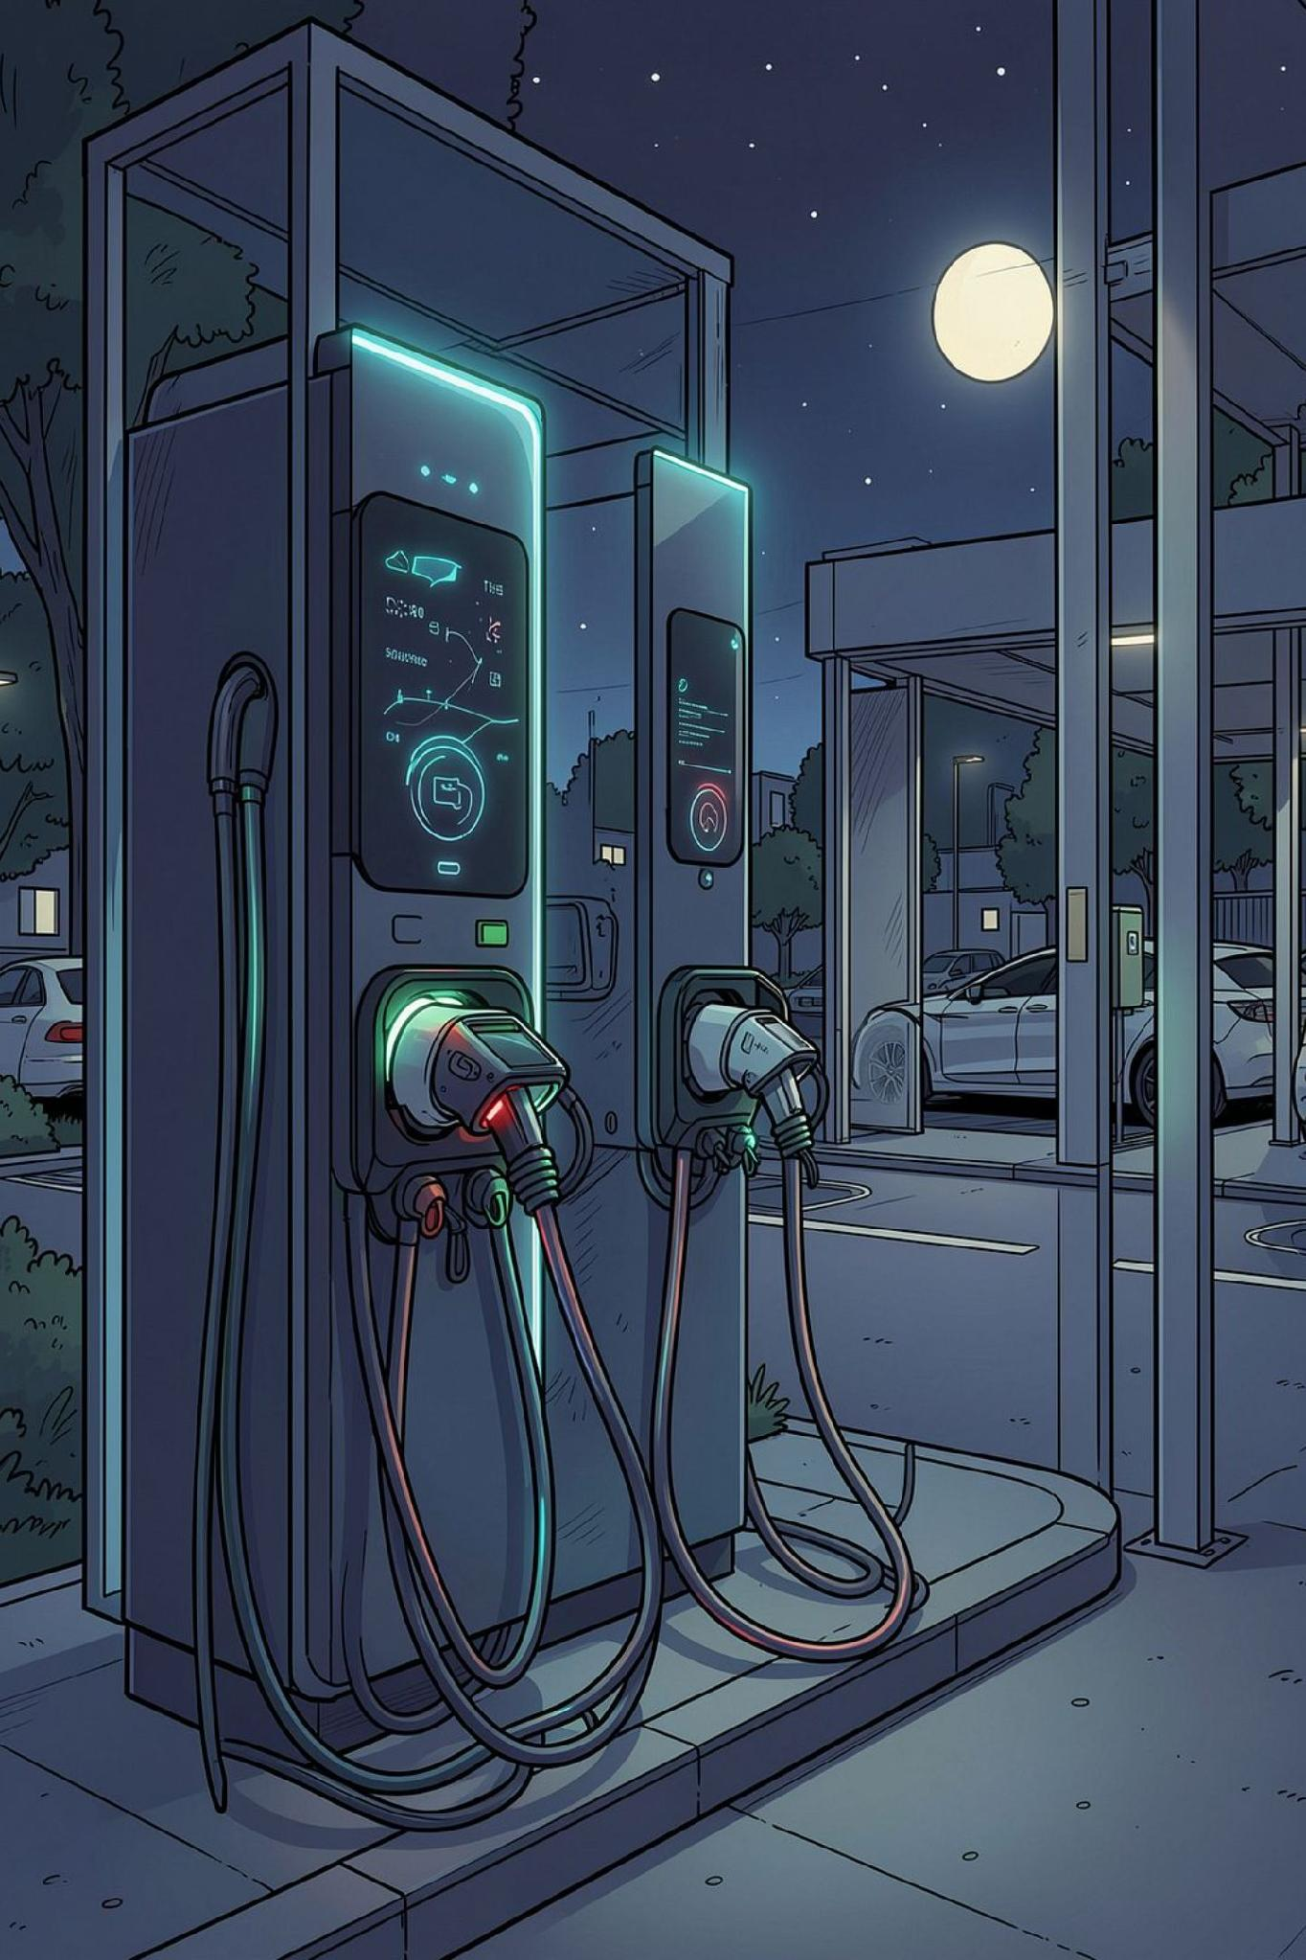
Smart EV Charging Station Optimizer
Dynamic Load Balancing via ESP32, Edge AI & ThingsBoard IoT Cloud
Project Lead: B. Kiran Kumar
Specialization: Smart Energy & Edge Computing Solutions
Implementation: Hardware-in-the-Loop Simulation & Cloud Architecture

Slide 2
PROBLEM STATEMENT
Grid Instability Under Concurrent EV Charging Demand
The Core Challenge
Design Objective
Concurrent EV charging introduces severe grid-level peak loads, risking transformer overloads and power outages. A restricted local supply of 5 kW is overwhelmed when three charging bays simultaneously demand 8 kW, with incoming vehicle queues compounding stress.
Engineer a decentralized, intelligent controller that monitors, predicts, and dynamically optimizes per-bay power allocation — preventing grid trips while maintaining fair, efficient charging throughput.
5 kW
8 kW
3 Bays
Local supply limit
Peak simultaneous demand
Charging stations managed

Slide 3



SYSTEM DESIGN
Proposed Solution: Three Pillars of Intelligent Control
Autonomous Edge Control
Predictive Edge AI
Centralized Telemetry
Dedicated ESP32 microcontrollers monitor local telemetry and execute fast cutoff/throttling decisions independent of internet latency.
On-device AI models predict session duration and vehicle arrival patterns, enabling proactive, fair power scheduling before congestion occurs.
ThingsBoard IoT cloud platform delivers live monitoring, historical analytics, automated alarm management, and remote operator override.

Slide 4
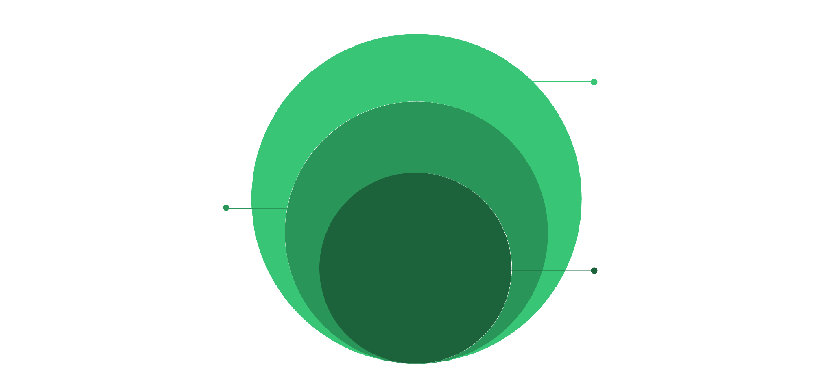
ARCHITECTURE
Three-Tier System Architecture
Edge Layer
ESP32 per bay, sensors, relays for control
Communication Layer
MQTT over TCP 1883/8883, telemetry and RPC
Cloud Layer
ThingsBoard, rule chains, dashboards, alarms
The architecture cleanly separates fast local control at the edge from cloud-level orchestration, with MQTT serving as the lightweight, high-speed messaging backbone between tiers.

Slide 5
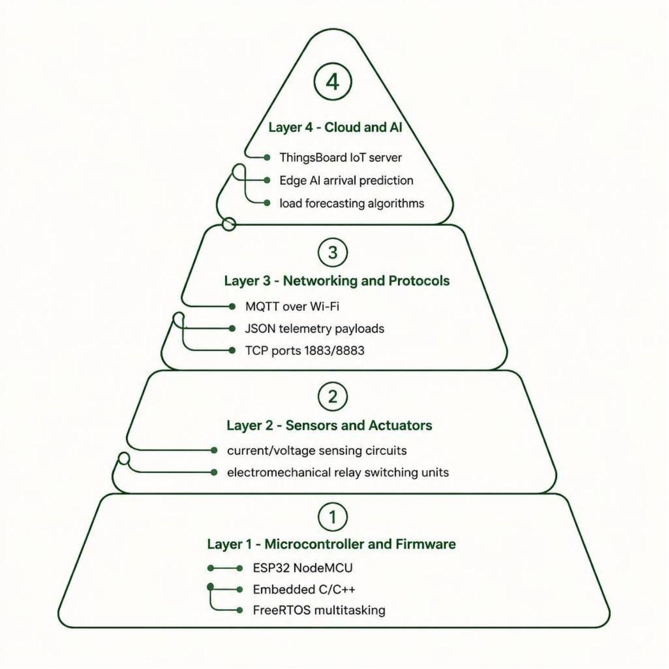
IMPLEMENTATION
Hardware & Software Stack
Key Design Choices
ESP32 NodeMCU selected for dual-core processing, Wi-Fi integration, and low power profile
FreeRTOS enables concurrent sensor polling, MQTT publishing, and AI inference tasks
MQTT chosen over HTTP for minimal overhead and publish/subscribe decoupling
ThingsBoard provides out-of-the-box rule engine, widget library, and device management

Slide 6




CONTROL LOGIC
Dynamic Load Optimization State Machine
ALLOW
THROTTLE
DEFER
Full-rate charging enabled. Total station load is well below the 5 kW limit.
Charging current dynamically reduced via PWM duty control as aggregated demand approaches capacity.
Incoming vehicles queued; non-critical bays suspended during peak stress until headroom clears.
Fail-Safe Protocol: Automatic fallback to local autonomous load limits is triggered if cloud connectivity is lost, ensuring uninterrupted grid protection.

Slide 7

DATA LAYER
Telemetry & Sensing Metrics
Monitored Electrical Variables
Edge-to-Cloud Data Pipeline
Raw sensor data undergoes edge filtering and local aggregation before structured JSON MQTT packets are transmitted. Continuous monitoring loops ensure sub-second response times during sudden over-current events, with cloud dashboards reflecting near-real-time state.
Line Voltage (V)
Load Current (A)
Per-phase RMS measurement for grid health assessment
Real-time per-bay current for overload detection
Active Power (kW)
Total Energy (kWh)
Aggregated station demand for state machine decisions
Cumulative consumption logged for billing and analytics

Slide 8

DEMONSTRATION
Live System Walkthrough
Demonstration Sequence
01
Bay Initialization
Real-time bring-up of multiple charging bays with sensor calibration
02
Peak Load Trigger
Simulated simultaneous demand exceeding the 5 kW grid limit
03
Algorithm Execution
Live THROTTLE and DEFER state transitions observed on hardware
04
Cloud Dashboard
ThingsBoard graphs updating and alarms triggering in real time

Slide 9

RESULTS
Experimental Results & Observations
5 kW
0
Peak Load Cap
Breaker Trips
Total station load constrained below threshold despite 8 kW simultaneous demand
Zero over-current faults recorded during rapid multi-vehicle connection cycles
<1s
100%
Response Time
Offline Robustness
Sub-second edge response during sudden over-current events
Edge controllers maintained valid load limits during simulated Wi-Fi disconnects
The system successfully demonstrated grid-safe operation under worst-case concurrent demand scenarios with no manual intervention required.

Slide 10

CONCLUSION
Summary & Future Scope
Project Summary
Future Enhancements
A scalable, cost-effective smart EV charging optimizer was engineered, integrating ESP32 microcontrollers, Edge AI prediction, and ThingsBoard IoT cloud services — achieving autonomous, grid-safe load management without proprietary hardware.
OCPP Compliance
Implement Open Charge Point Protocol for interoperability with commercial chargers
Tariff Optimization
Dynamic time-of-day utility pricing integration for cost-aware scheduling
Renewable Integration
Solar PV generation and Battery Energy Storage (BESS) buffer support

